Slide 1
Containers’n stuff
Andreas Mosti | Bendik Solheim | Trym Sneltvedt
Bekk Consulting

Slide 2
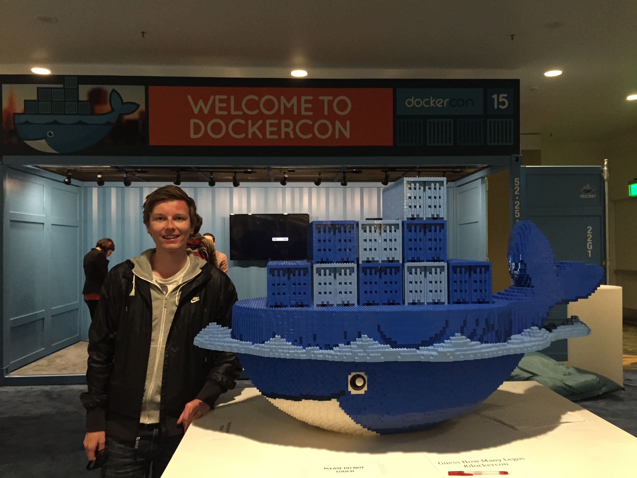

Slide 3
Why containers?

Slide 4



Slide 5


Slide 6







Slide 7



Slide 8
Shipping is hard!

Slide 9


Slide 10


Slide 11
Specification for packaging,
shipping and running services

Slide 12
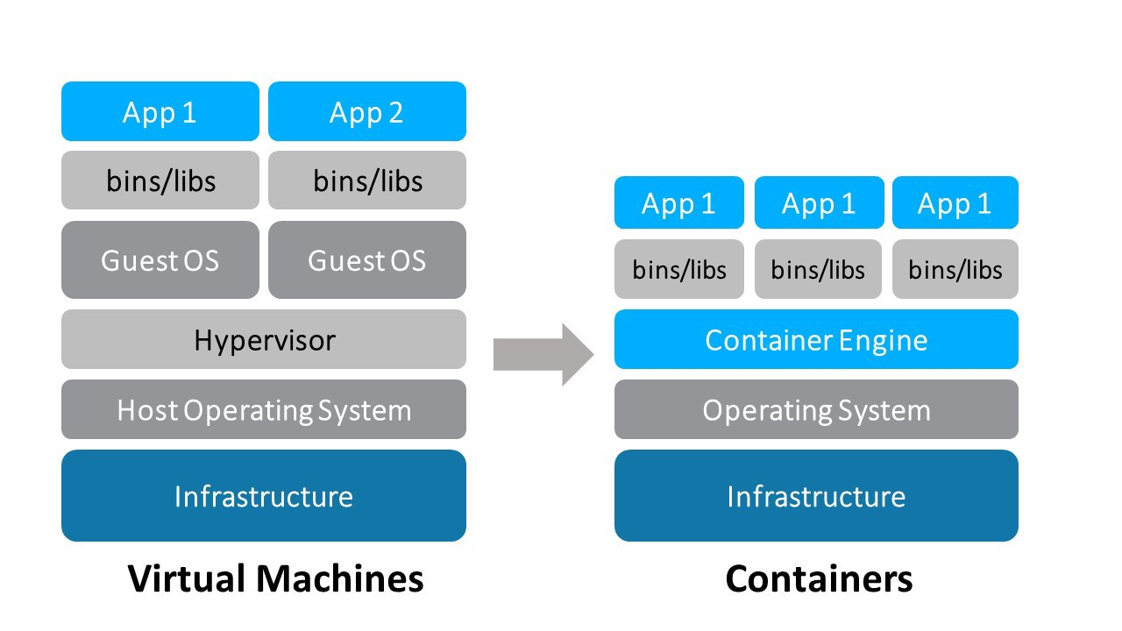

Slide 13
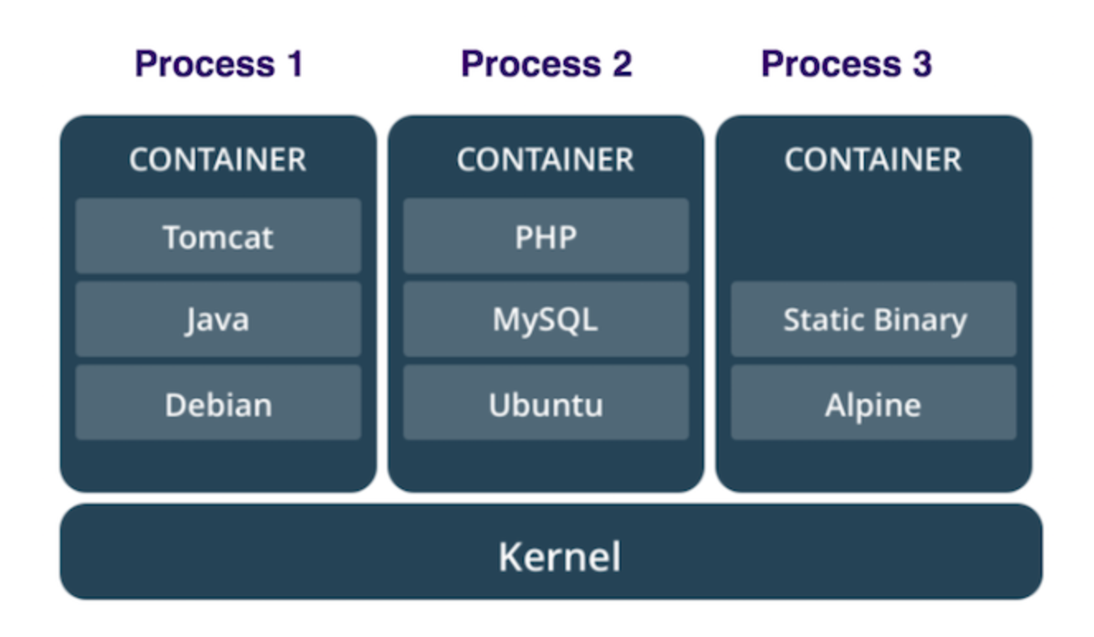

Slide 14
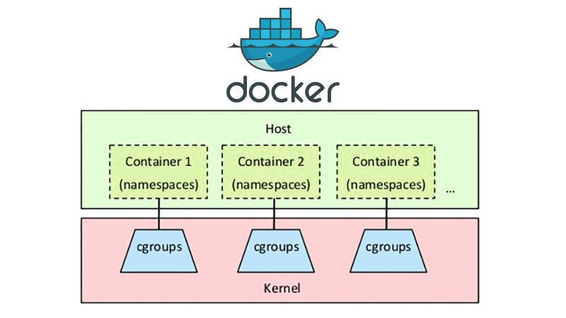
Notes:
cgroups (abbreviated from control groups) is a Linux kernel feature that limits, accounts for, and isolates the resource usage (CPU, memory, disk I/O, network, etc.) of a collection of processes. While not technically part of the cgroups work, a related feature of the Linux kernel is namespace isolation, where groups of processes are separated such that they cannot "see" resources in other groups.

Slide 16
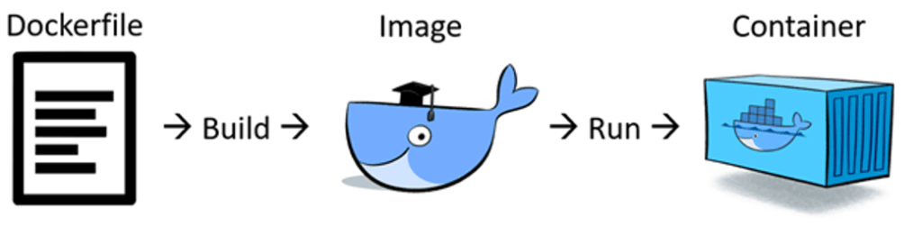

Slide 17
Containers are minimal

Slide 18
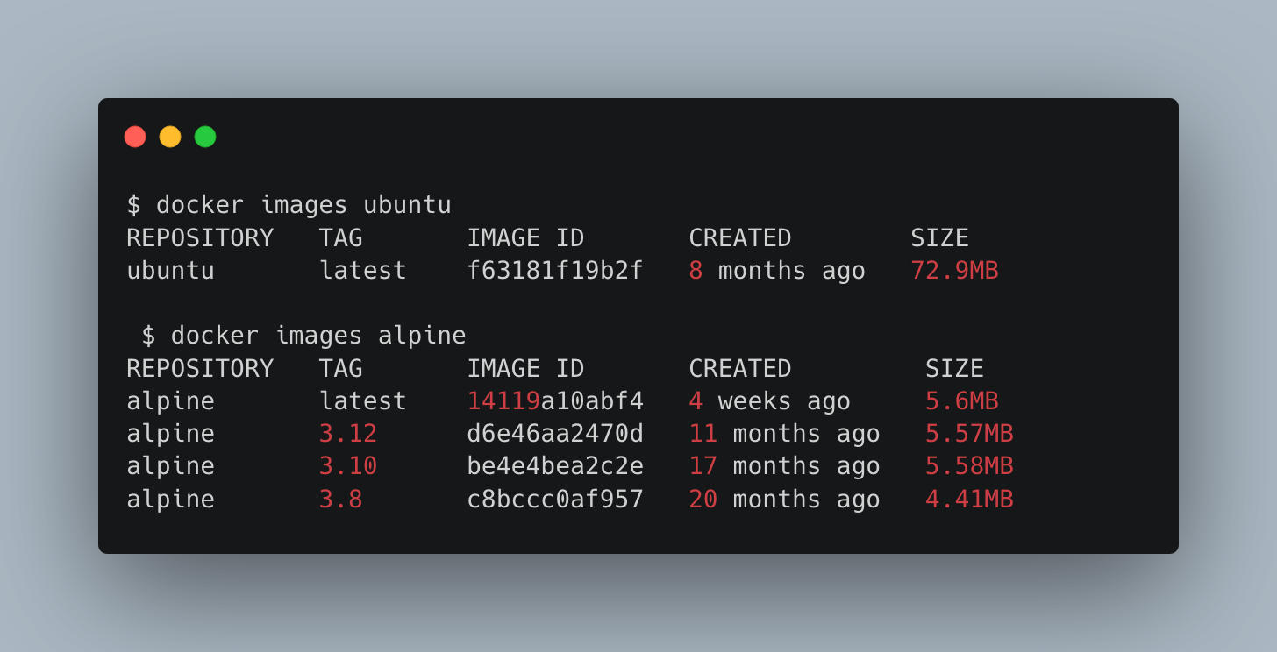

Slide 19
Containers are task-specific

Slide 20
Containers are isolated

Slide 21
Containers are reproducible (ish)

Slide 22


Slide 23
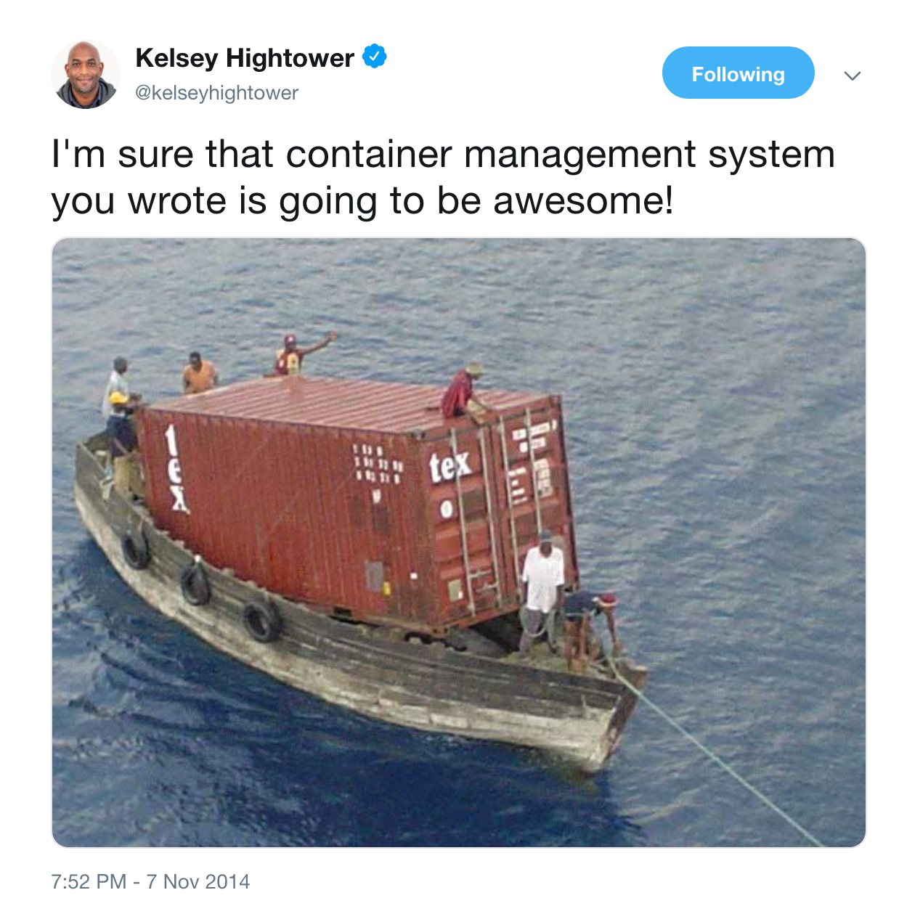

Slide 24


Slide 25
